Slide 1
Vectored Thrust Aircraft Final Project
Jiangwen Cheng
Department of Mechanical Engineering

Slide 2
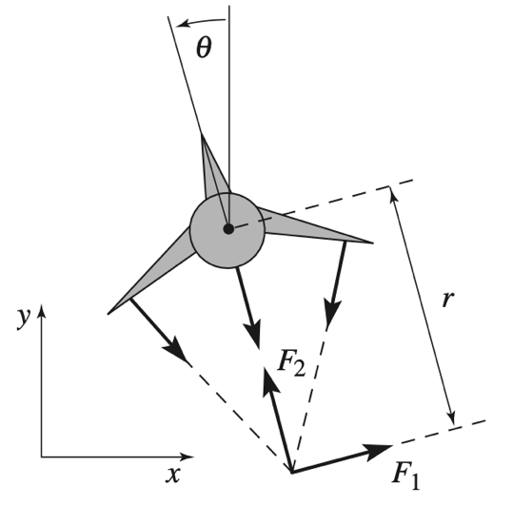
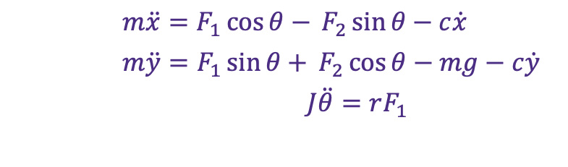

Modeling
Simplified Model of Harrier “Jump Jet”
$m\ddot{x}=F_{1}\cos{θ− }F_{2}\sin{θ}−c\dot{x}$
$m\ddot{y}=F_{1}\sin{θ+ }F_{2}\cos{θ}−mg−c\dot{y}$
$J\ddot{θ}=rF_{1}$
Input u1 = F1, u2 = F2- mg
State variables $ζ$ = (x, y, $θ, \dot{x}, \dot{y}, \dot{θ}$)
Fig. 1. Simplified Model of the Aircraft

Slide 3
System Analysis
We can tell the system is a dynamic, continuous, nonlinear, time-invariant, and casual system. Given the presence of second-order time derivatives and forces that depend on time (as indicated by terms involving θ), the system described by equations is dynamic. It models the motion and behavior of the system over time, considering forces, accelerations, and their interdependencies. The system is continuous because it involves continuous-time derivatives. The system is nonlinear due to the presence of trigonometric functions. The system equations do not contain explicit dependence on time, and there are no time-varying parameters. The coefficients and parameters in the equations remain constant over time. Therefore, it’s also a time-invariant system. The system is causal as the accelerations depend on current and past values, not future values.

Slide 4
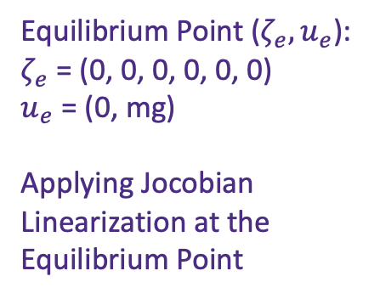
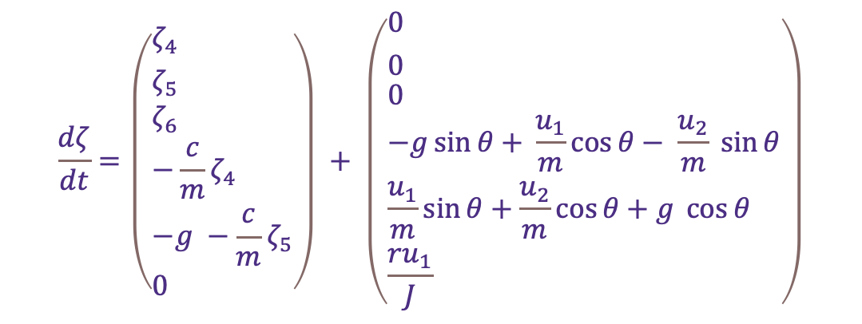
State Space Form and Linearization
State Form Before Linearization
$$\frac{dζ}{dt}=\left(\begin{aligned}&{ζ_{4} \atop ζ_{5}} \\ &ζ_{6} \\ &−\frac{c}{m}ζ_{4} \\ &−g −\frac{c}{m}ζ_{5} \\ &0\end{aligned}\right) + \left(\begin{aligned}&{0 \atop 0} \\ &0 \\ &−g\sin{θ+ }\frac{u_{1}}{m}\cos{θ− \frac{u_{2}}{m} \sin{θ}} \\ &\frac{u_{1}}{m}sin{θ+\frac{u_{2}}{m}\cos{θ}+g \cos{θ}} \\ &\frac{ru_{1}}{J}\end{aligned}\right)$$
Equilibrium Point ($ζ_{e}{, u}_{e}$):
$ζ_{e}$ = (0, 0, 0, 0, 0, 0)
$u_{e}$ = (0, mg)
Applying Jocobian Linearization at the Equilibrium Point

Slide 5

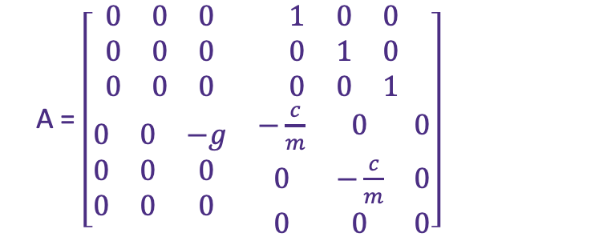
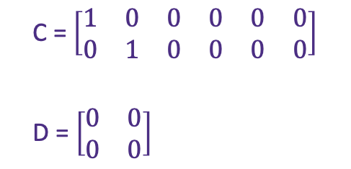
State Space Matrix of Linearized System
B = $\left[\begin{matrix}\begin{matrix}0 & 0 \\ 0 & 0 \\ 0 & 0\end{matrix} \\ \begin{matrix}\frac{1}{m} & 0 \\ 0 & \frac{1}{m} \\ \frac{r}{J} & 0\end{matrix}\end{matrix}\right]$
A = $\left[\begin{matrix}\begin{matrix}0 & 0 & 0 \\ 0 & 0 & 0 \\ 0 & 0 & 0\end{matrix} & \begin{matrix}1 & 0 & 0 \\ 0 & 1 & 0 \\ 0 & 0 & 1\end{matrix} \\ \begin{matrix}0 & 0 & −g \\ 0 & 0 & 0 \\ 0 & 0 & 0\end{matrix} & \begin{matrix}−\frac{c}{m} & 0 & 0 \\ 0 & −\frac{c}{m} & 0 \\ 0 & 0 & 0\end{matrix}\end{matrix}\right]$
C = $\left[\begin{matrix}\begin{matrix}1 & 0 & 0 \\ 0 & 1 & 0\end{matrix} & \begin{matrix}0 & 0 & 0 \\ 0 & 0 & 0\end{matrix}\end{matrix}\right]$
D = $\left[\begin{matrix}0 & 0 \\ 0 & 0\end{matrix}\right]$
Symbols | Description | Value
m | Aircraft mass | 4. 0 kg
J | Aircraft Inertia | 0.00475 kg m^2
r | Force moment distance | 0.25 m
c | Damping coefficient | 0.05 kg m/s
g | Gravitational constant | 9.8 m/s^2
Table I: Parameters in the System

Slide 6
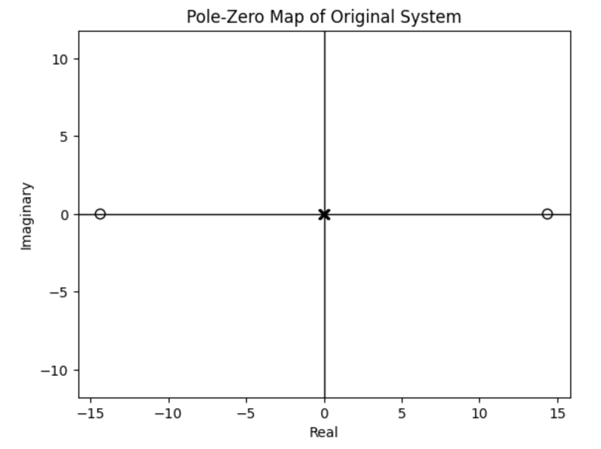
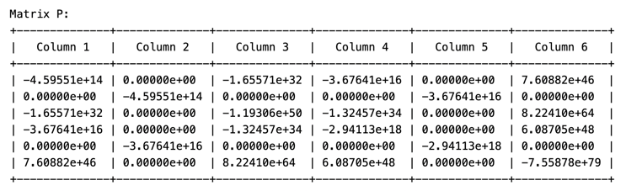
Stability of the System using Eigenvalues and Lyapunov Function
Eigenvalues of the original system are [ 0, -0.0125, 0, 0, -0.0125, 0] and the pole-zero map at the left side. The map tells us the system is unstable.
Using Lyapunov stability theorem, arbitrary choosing identity matrix for Q and P matrix can be found, referring Fig.3 at left. Eigenvalues of P are [-4.59551e+14, -7.55878e+79, -2.98266e+49, -9.80375e+17, -2.94159e+18, -2.49953e-02] , which all are negative . That means P matrix doesn’t satisfy positive definite matrix definition, it’s clear that the system is unstable.
Fig. 2. Pole-Zero Map of Original System
Fig. 3. P Matrix of Lyapunov

Slide 7
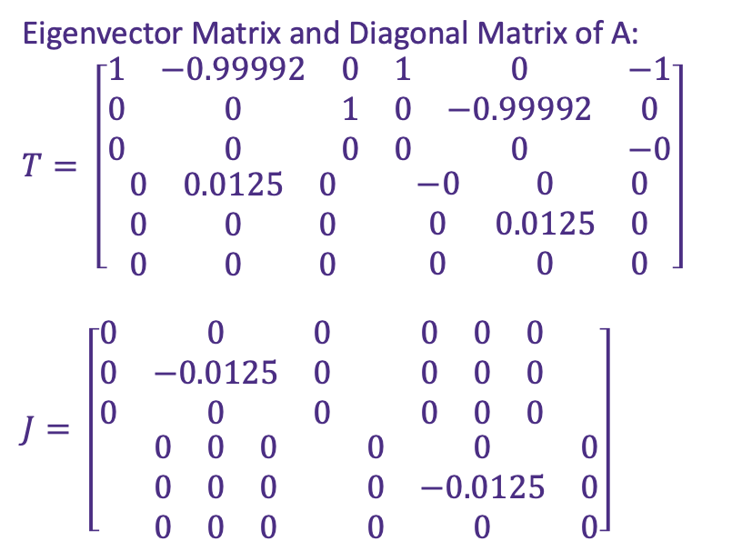

Similarity Transformation
A Matrix Decomposition:
A = ${TJT}^{−1}$
Eigenvector Matrix and Diagonal Matrix of A:
$$T= \left[\begin{matrix}\begin{matrix}1 & −0.99992 & 0 \\ 0 & 0 & 1 \\ 0 & 0 & 0\end{matrix} & \begin{matrix}1 & 0 & −1 \\ 0 & −0.99992 & 0 \\ 0 & 0 & −0\end{matrix} \\ \begin{matrix}0 & 0.0125 & 0 \\ 0 & 0 & 0 \\ 0 & 0 & 0\end{matrix} & \begin{matrix}−0 & 0 & 0 \\ 0 & 0.0125 & 0 \\ 0 & 0 & 0\end{matrix}\end{matrix}\right]$$
$$J= \left[\begin{matrix}\begin{matrix}0 & 0 & 0 \\ 0 & −0.0125 & 0 \\ 0 & 0 & 0\end{matrix} & \begin{matrix}0 & 0 & 0 \\ 0 & 0 & 0 \\ 0 & 0 & 0\end{matrix} \\ \begin{matrix}0 & 0 & 0 \\ 0 & 0 & 0 \\ 0 & 0 & 0\end{matrix} & \begin{matrix}0 & 0 & 0 \\ 0 & −0.0125 & 0 \\ 0 & 0 & 0\end{matrix}\end{matrix}\right]$$

Slide 8
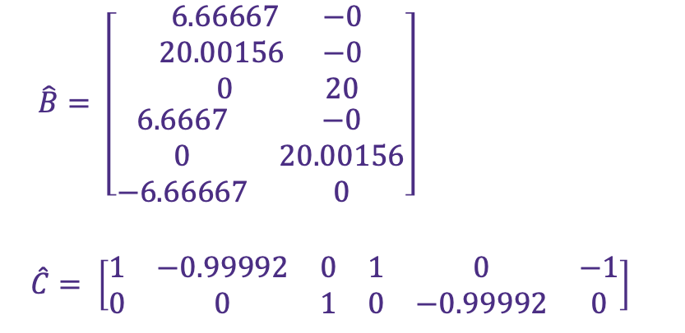
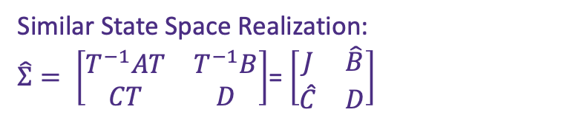
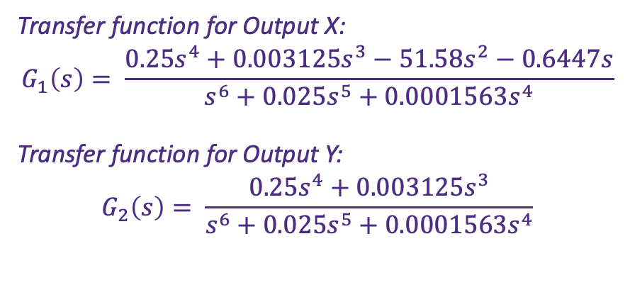
Transformed System in State Space Form and Transfer Functions
Similar State Space Realization:
$\hat{Σ}= \left[\begin{matrix}T^{−1}AT & T^{−1}B \\ CT & D\end{matrix}\right]$= $\left[\begin{matrix}J & \hat{B} \\ \hat{C} & D\end{matrix}\right]$
Transfer function for Output X:
$$G_{1}\left(s\right)= \frac{0.25s^{4}+0.003125s^{3}−51.58s^{2}−0.6447s}{s^{6}+0.025s^{5}+0.0001563s^{4}}$$
Transfer function for Output Y:
$$G_{2}\left(s\right)= \frac{0.25s^{4}+0.003125s^{3}}{s^{6}+0.025s^{5}+0.0001563s^{4}}$$
$$\hat{B}= \left[\begin{matrix}\begin{matrix}6.66667 & −0 \\ 20.00156 & −0 \\ 0 & 20\end{matrix} \\ \begin{matrix}6.6667 & −0 \\ 0 & 20.00156 \\ −6.66667 & 0\end{matrix}\end{matrix}\right]$$
$$\hat{C}= \left[\begin{matrix}\begin{matrix}1 & −0.99992 & 0 \\ 0 & 0 & 1\end{matrix} & \begin{matrix}1 & 0 & −1 \\ 0 & −0.99992 & 0\end{matrix}\end{matrix}\right]$$

Slide 9
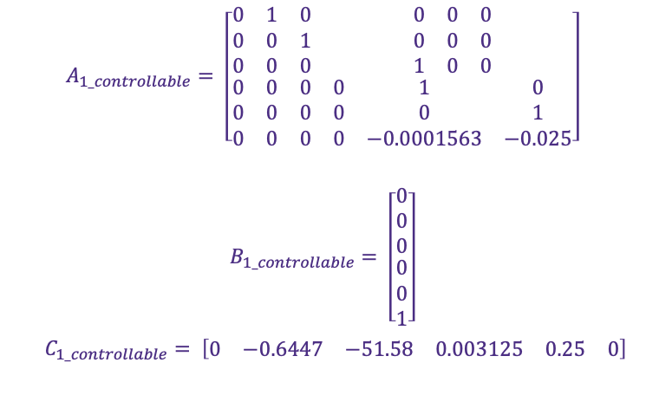

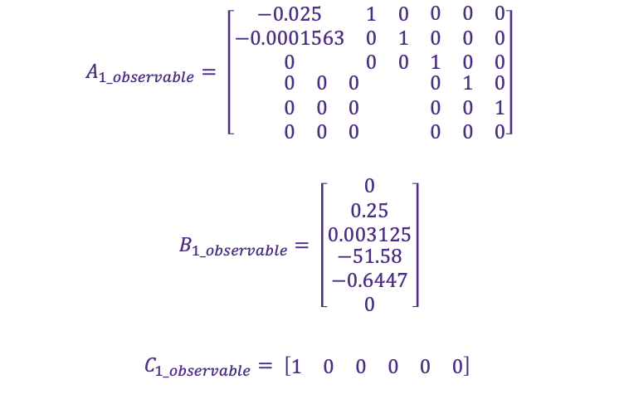
Controllable and Observable Canonical Form of Transfer Function $G_{1}(s)$
$$A_{1_controllable}= \left[\begin{matrix}\begin{matrix}0 & 1 & 0 \\ 0 & 0 & 1 \\ 0 & 0 & 0\end{matrix} & \begin{matrix}0 & 0 & 0 \\ 0 & 0 & 0 \\ 1 & 0 & 0\end{matrix} \\ \begin{matrix}0 & 0 & 0 \\ 0 & 0 & 0 \\ 0 & 0 & 0\end{matrix} & \begin{matrix}0 & 1 & 0 \\ 0 & 0 & 1 \\ 0 & −0.0001563 & −0.025\end{matrix}\end{matrix}\right]$$
$$B_{1_controllable}= \left[\begin{matrix}\begin{matrix}0 \\ 0 \\ 0\end{matrix} \\ \begin{matrix}0 \\ 0 \\ 1\end{matrix}\end{matrix}\right]$$
$$C_{1_controllable}= \left[\begin{matrix}\begin{matrix}0 & −0.6447 & −51.58\end{matrix} & \begin{matrix}0.003125 & 0.25 & 0\end{matrix}\end{matrix}\right]$$
$$A_{1_observable}= \left[\begin{matrix}\begin{matrix}−0.025 & 1 & 0 \\ −0.0001563 & 0 & 1 \\ 0 & 0 & 0\end{matrix} & \begin{matrix}0 & 0 & 0 \\ 0 & 0 & 0 \\ 1 & 0 & 0\end{matrix} \\ \begin{matrix}0 & 0 & 0 \\ 0 & 0 & 0 \\ 0 & 0 & 0\end{matrix} & \begin{matrix}0 & 1 & 0 \\ 0 & 0 & 1 \\ 0 & 0 & 0\end{matrix}\end{matrix}\right]$$
$$B_{1_observable}= \left[\begin{matrix}\begin{matrix}0 \\ 0.25 \\ 0.003125\end{matrix} \\ \begin{matrix}−51.58 \\ −0.6447 \\ 0\end{matrix}\end{matrix}\right]$$
$$C_{1_observable}= \left[\begin{matrix}\begin{matrix}1 & 0 & 0\end{matrix} & \begin{matrix}0 & 0 & 0\end{matrix}\end{matrix}\right]$$

Slide 10
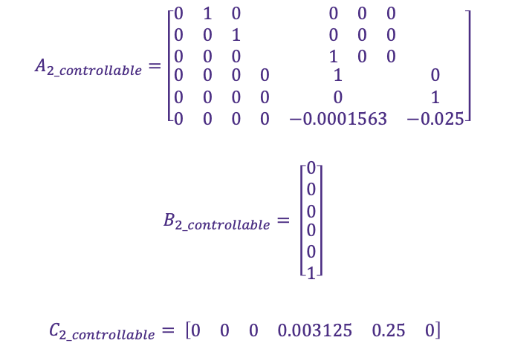

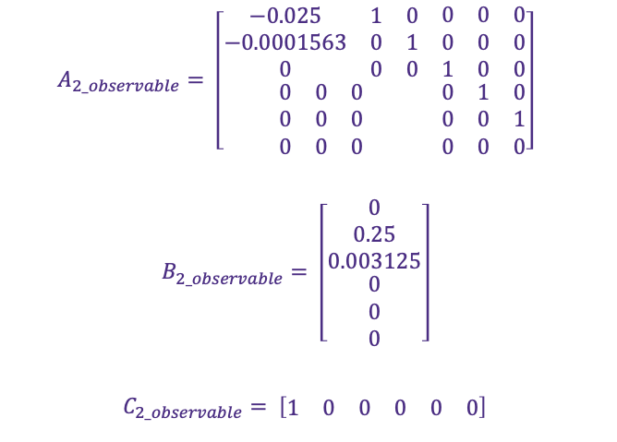
Controllable and Observable Canonical Form of Transfer Function $G_{2}(s)$
$$A_{2_controllable}=\left[\begin{matrix}\begin{matrix}0 & 1 & 0 \\ 0 & 0 & 1 \\ 0 & 0 & 0\end{matrix} & \begin{matrix}0 & 0 & 0 \\ 0 & 0 & 0 \\ 1 & 0 & 0\end{matrix} \\ \begin{matrix}0 & 0 & 0 \\ 0 & 0 & 0 \\ 0 & 0 & 0\end{matrix} & \begin{matrix}0 & 1 & 0 \\ 0 & 0 & 1 \\ 0 & −0.0001563 & −0.025\end{matrix}\end{matrix}\right]$$
$$B_{2_controllable}= \left[\begin{matrix}\begin{matrix}0 \\ 0 \\ 0\end{matrix} \\ \begin{matrix}0 \\ 0 \\ 1\end{matrix}\end{matrix}\right]$$
$$C_{2_controllable}= \left[\begin{matrix}\begin{matrix}0 & 0 & 0\end{matrix} & \begin{matrix}0.003125 & 0.25 & 0\end{matrix}\end{matrix}\right]$$
$$A_{2_observable}= \left[\begin{matrix}\begin{matrix}−0.025 & 1 & 0 \\ −0.0001563 & 0 & 1 \\ 0 & 0 & 0\end{matrix} & \begin{matrix}0 & 0 & 0 \\ 0 & 0 & 0 \\ 1 & 0 & 0\end{matrix} \\ \begin{matrix}0 & 0 & 0 \\ 0 & 0 & 0 \\ 0 & 0 & 0\end{matrix} & \begin{matrix}0 & 1 & 0 \\ 0 & 0 & 1 \\ 0 & 0 & 0\end{matrix}\end{matrix}\right]$$
$$B_{2_observable}= \left[\begin{matrix}\begin{matrix}0 \\ 0.25 \\ 0.003125\end{matrix} \\ \begin{matrix}0 \\ 0 \\ 0\end{matrix}\end{matrix}\right]$$
$$C_{2_observable}= \left[\begin{matrix}\begin{matrix}1 & 0 & 0\end{matrix} & \begin{matrix}0 & 0 & 0\end{matrix}\end{matrix}\right]$$

Slide 11
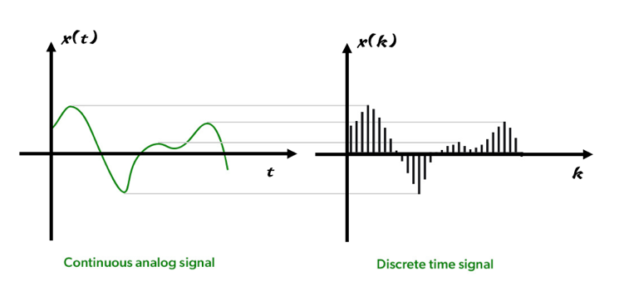
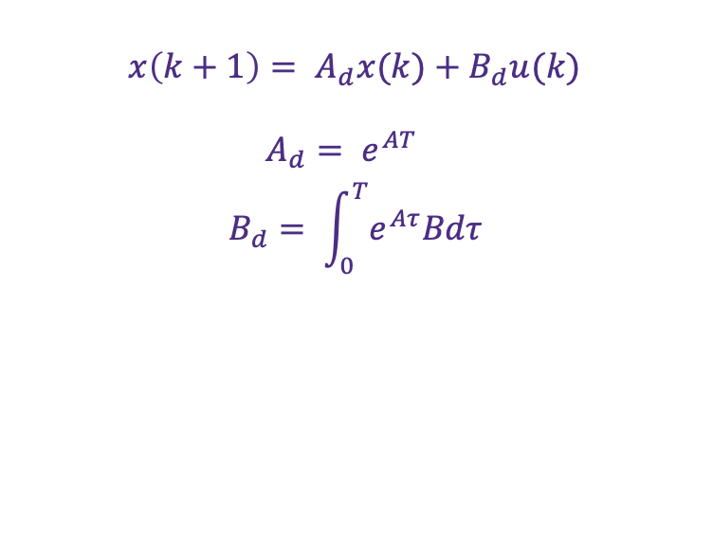
Discrete Time State Space Model
Applying the sampling time in the discrete time interval, solution of original system at discrete time can be calculated by following equations:
$x\left(k+1\right)= A_{d}x(k)+B_{d}u(k)$
$$A_{d}= e^{AT}$$
$$B_{d}= \int_{0}^{T}{e^{Aτ}Bdτ}$$
Fig.4. Converting Continuous Signal to Discrete Signal
Fig. 4. shown as following is used to illustrate converting time function to discrete sequence.

Slide 12
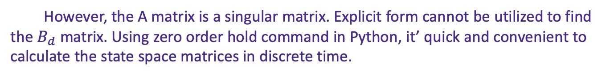
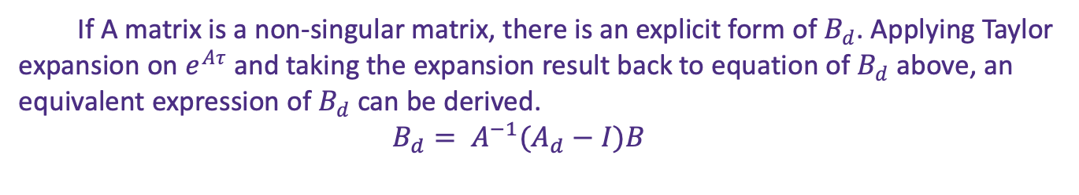
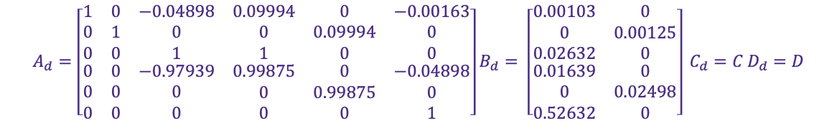
Cont.
If A matrix is a non-singular matrix, there is an explicit form of $B_{d}$. Applying Taylor expansion on $e^{Aτ}$ and taking the expansion result back to equation of $B_{d}$ above, an equivalent expression of $B_{d}$ can be derived.
$B_{d}= A^{−1}(A_{d}−I)B$
However, the A matrix is a singular matrix. Explicit form cannot be utilized to find the $B_{d}$ matrix. Using zero order hold command in Python, it’ quick and convenient to calculate the state space matrices in discrete time.
$$A_{d}=\left[\begin{matrix}\begin{matrix}1 & 0 & −0.04898 \\ 0 & 1 & 0 \\ 0 & 0 & 1\end{matrix} & \begin{matrix}0.09994 & 0 & −0.00163 \\ 0 & 0.09994 & 0 \\ 1 & 0 & 0\end{matrix} \\ \begin{matrix}0 & 0 & −0.97939 \\ 0 & 0 & 0 \\ 0 & 0 & 0\end{matrix} & \begin{matrix}0.99875 & 0 & −0.04898 \\ 0 & 0.99875 & 0 \\ 0 & 0 & 1\end{matrix}\end{matrix}\right]B_{d}= \left[\begin{matrix}\begin{matrix}0.00103 & 0 \\ 0 & 0.00125 \\ 0.02632 & 0\end{matrix} \\ \begin{matrix}0.01639 & 0 \\ 0 & 0.02498 \\ 0.52632 & 0\end{matrix}\end{matrix}\right] C_{d}=C D_{d}=D$$

Slide 13
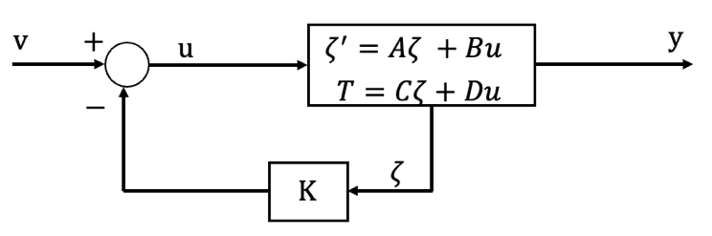
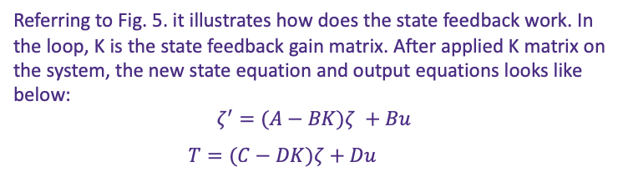
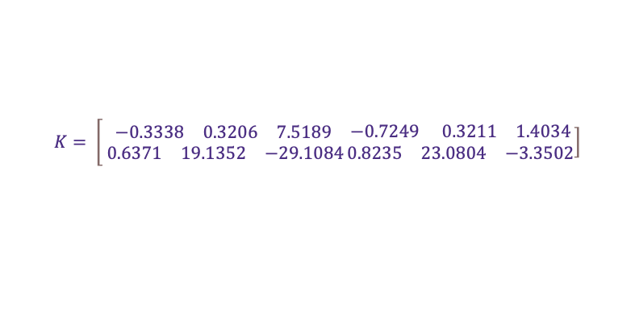
State Feedback Control
Referring to Fig. 5. it illustrates how does the state feedback work. In the loop, K is the state feedback gain matrix. After applied K matrix on the system, the new state equation and output equations looks like below:
$$ζ^{′}=(A−BK)ζ +Bu$$
$T=(C−DK)ζ+Du$
Fig. 5. State Feedback Structure Illustration
Arbitrary eigenvalues are selected for the state feedback:
Two pairs of complex conjugates $−3± 5j$ and $−0.5± 0.5j$, and two negative real numbers -1 and -5 are selected for the system poles.
$$K= \left[\begin{matrix}\begin{matrix}−0.3338 & 0.3206 & 7.5189\end{matrix} \\ \begin{matrix} 0.6371 & 19.1352 & −29.1084\end{matrix}\end{matrix}\right.\left.\begin{matrix}\begin{matrix}−0.7249 & 0.3211 & 1.4034\end{matrix} \\ \begin{matrix}0.8235 & 23.0804 & −3.3502\end{matrix}\end{matrix}\right]$$

Slide 14
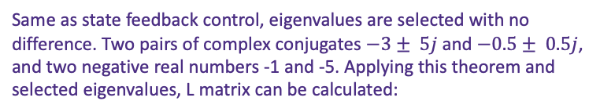
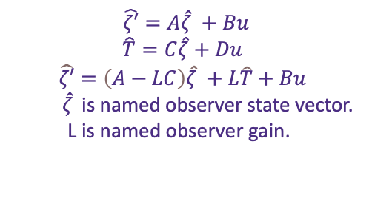
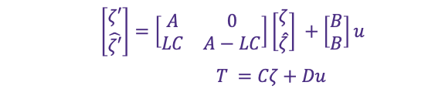
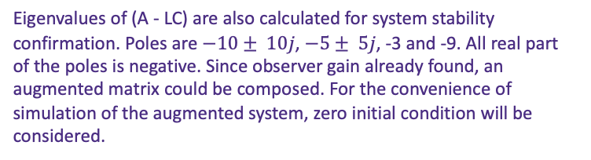
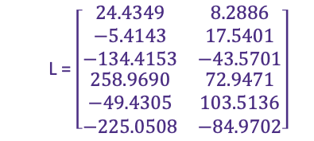
Observer State Feedback Control
Same as state feedback control, eigenvalues are selected with no difference. Two pairs of complex conjugates $−3± 5j$ and $−0.5± 0.5j$, and two negative real numbers -1 and -5. Applying this theorem and selected eigenvalues, L matrix can be calculated:
$\hat{ζ′}=A\hat{ζ} +Bu$
$$\hat{T}=C\hat{ζ}+Du$$
$$\hat{ζ′}=\left(A−LC\right)\hat{ζ} +L\hat{T}+Bu$$
$\hat{ζ}$ is named observer state vector.
L is named observer gain.
L = $\left[\begin{matrix}\begin{matrix}24.4349 & 8.2886 \\ −5.4143 & 17.5401 \\ −134.4153 & −43.5701\end{matrix} \\ \begin{matrix}258.9690 & 72.9471 \\ −49.4305 & 103.5136 \\ −225.0508 & −84.9702\end{matrix}\end{matrix}\right]$
Eigenvalues of (A - LC) are also calculated for system stability confirmation. Poles are $−10± 10j$, $−5± 5j$, -3 and -9. All real part of the poles is negative. Since observer gain already found, an augmented matrix could be composed. For the convenience of simulation of the augmented system, zero initial condition will be considered.
$\left[\begin{matrix}ζ′ \\ \hat{ζ′}\end{matrix}\right]=\left[\begin{matrix}A & 0 \\ LC & A−LC\end{matrix}\right]\left[\begin{matrix}ζ \\ \hat{ζ}\end{matrix}\right] +\left[\begin{matrix}B \\ B\end{matrix}\right]u$
$T =Cζ+Du$

Slide 15
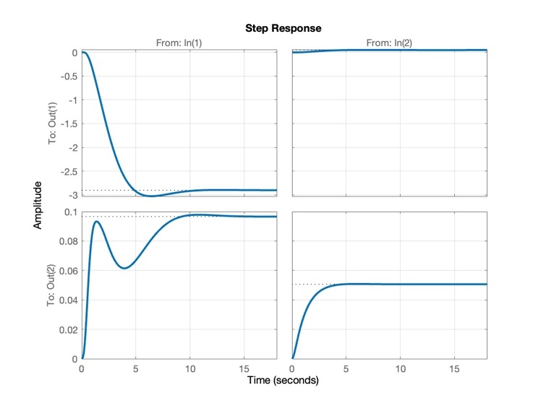
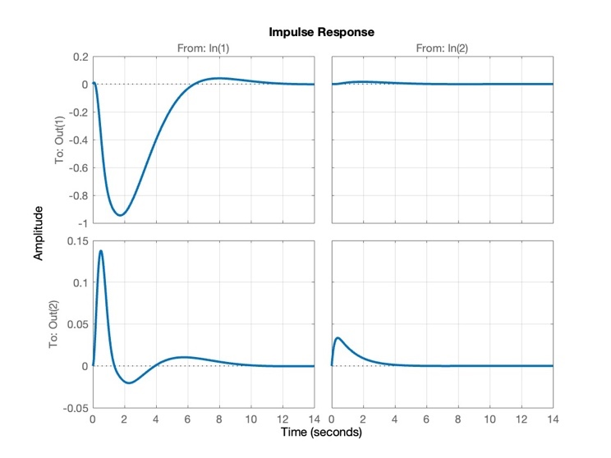
Simulation of State Feedback Control
Fig.6. Step Response of State Feedback Control
Fig.7. Impulse Response of State Feedback Control
In state feedback control, the step response indicates stability as time approaches infinity. Specifically in the context of an aircraft, it initially exhibits horizontal motion before reaching a settled state. The aircraft achieves horizontal movement and stabilization within a second. Additionally, with an impulse input, the system attains stability.

Slide 16
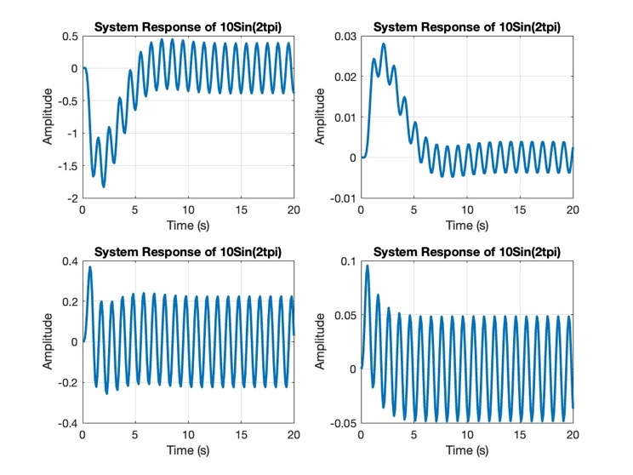
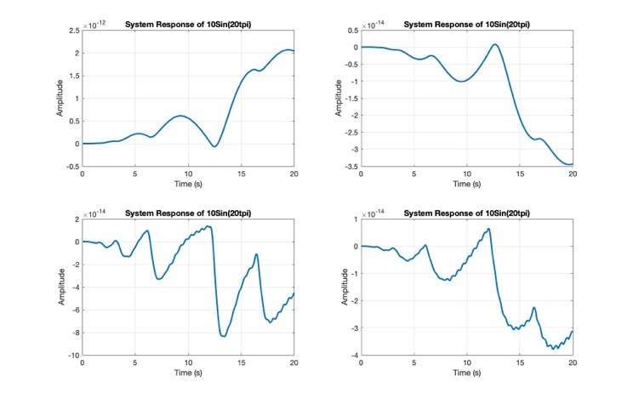
Cont.
Fig.8. Sinusoidal Response (10sin ($2πt$))
Fig.9. Sinusoidal Response (10sin ($20πt)$
Introducing a sinusoidal input also ensures stability, the system exhibits periodic oscillations that persist indefinitely.

Slide 17
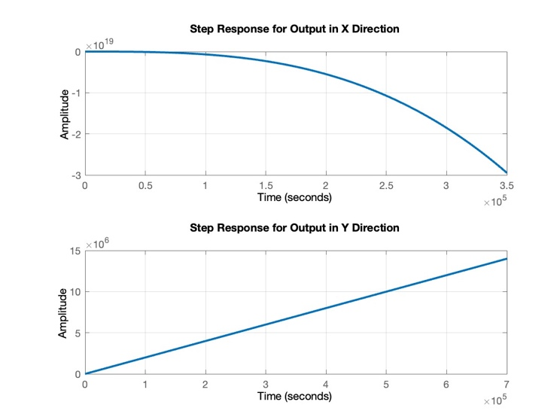
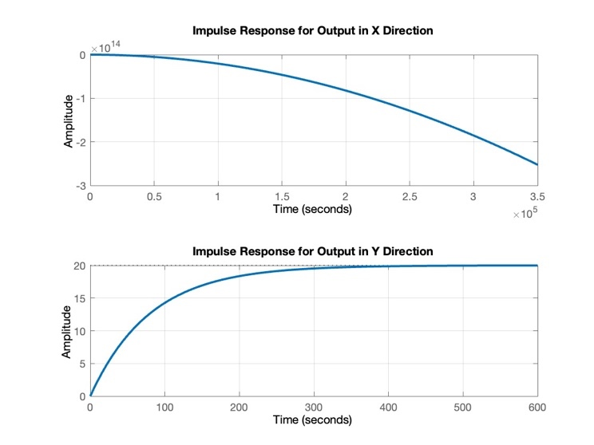
Simulation of Observer State Feedback Control
Fig.10. Step Response of Observer State Feedback Control
Fig.11. Impulse Response of Observer State Feedback Control

Slide 18
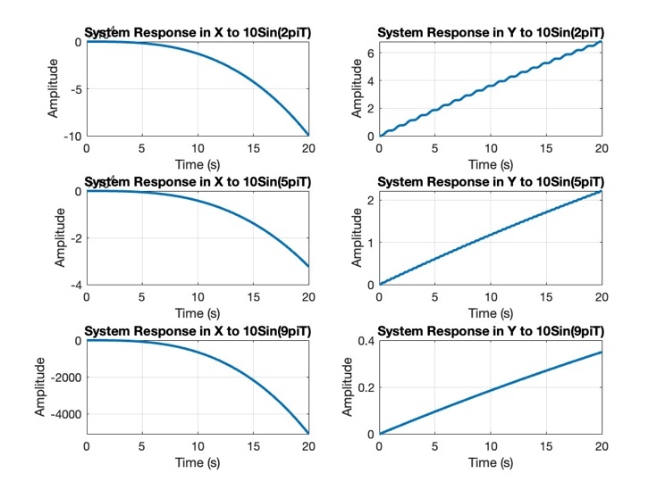
Cont.
In observer state feedback control, it’s evident that system stability is unattainable for various inputs. In the x-direction, the response consistently trends in a negative direction for all input scenarios. The behavior in the y-direction varies slightly between step and impulse inputs. With an impulse input, the aircraft takes several minutes to reach a stable state—a notably lengthy settling time. However, for step and sinusoidal inputs, the aircraft perpetually fails to settle and instead moves towards an infinitely distant position. These observations collectively indicate that the system, under observer state feedback control, is inherently incapable of achieving stability.
Fig.12. Sinusoidal Response of Observer State Feedback Control

Slide 19

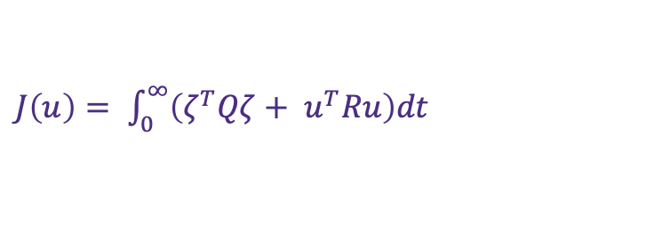
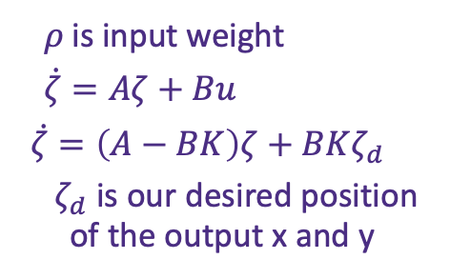
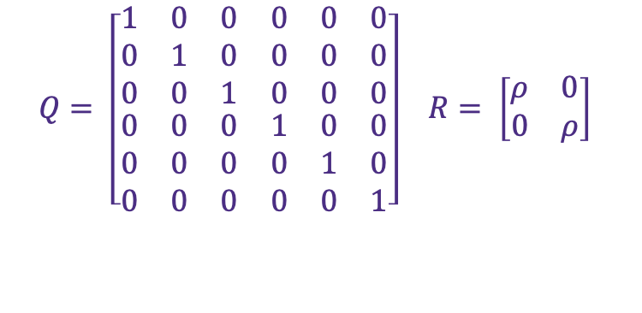
Applying Linear Quadratic Regulators (LQR)
$J\left(u\right)= \int_{0}^{∞}{\left(ζ^{T}Qζ+ u^{T}Ru\right)dt}$
$Q= \left[\begin{matrix}\begin{matrix}1 & 0 & 0 \\ 0 & 1 & 0 \\ 0 & 0 & 1\end{matrix} & \begin{matrix}0 & 0 & 0 \\ 0 & 0 & 0 \\ 0 & 0 & 0\end{matrix} \\ \begin{matrix}0 & 0 & 0 \\ 0 & 0 & 0 \\ 0 & 0 & 0\end{matrix} & \begin{matrix}1 & 0 & 0 \\ 0 & 1 & 0 \\ 0 & 0 & 1\end{matrix}\end{matrix}\right]$ $R= \left[\begin{matrix}ρ & 0 \\ 0 & ρ\end{matrix}\right]$
$ζ =ζ−ζ_{e}$, u = $u− u_{e}$ represent the local coordinates around the desired equilibrium point ($z_{e}$, $u_{e}$)
Applying code [K, S, E] = lqr(A, B, Q, R), we can get the new controlled system, which E is the eigenvalues of the new system.
$ρ$ is input weight
$\dot{ζ}=Aζ+Bu$
$$\dot{ζ}=\left(A−BK\right)ζ+BKζ_{d}$$
$ζ_{d}$ is our desired position of the output x and y

Slide 20
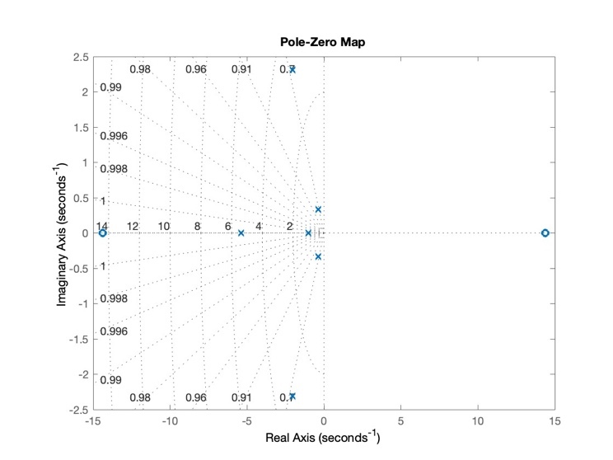
Pole- Zero Map
Under the LQR control, the system have all poles at the left half of pole-zero map, that means the controlled system achieved stability. The aircraft can reach balance state.
Fig.13. Pole-Zero Map of Controlled Closed Loop System

Slide 21
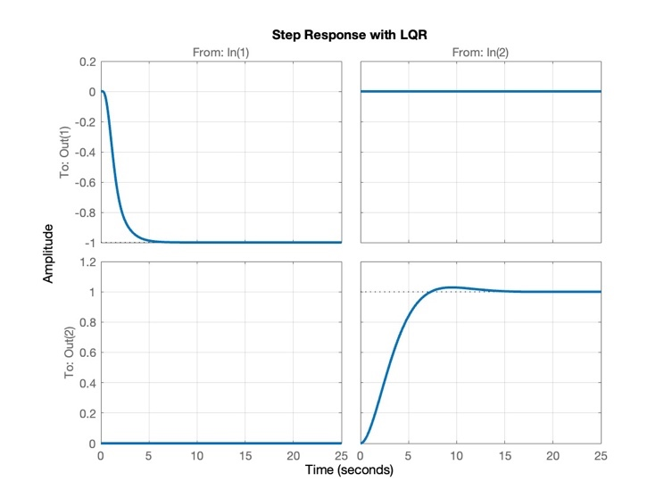
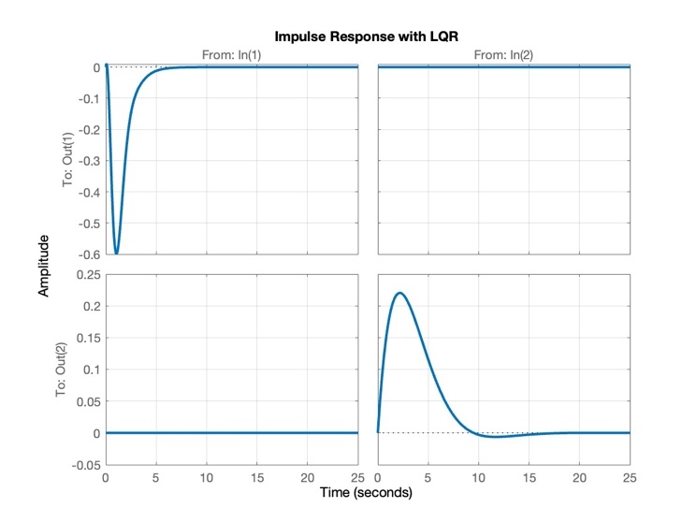
Step and Impulse Response
Fig.14. Step Response of System with LQR
Fig.15. Impulse Response of System with LQR

Slide 22
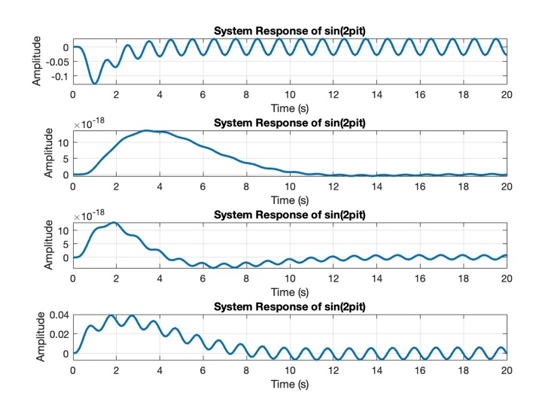
Cont.
Based on above figures, the system response converges to a stable state no matter in what kind of input signal. The aircraft will move to the negative direction of x a little bit in a second and move to 1 meter height in y direction in a second under step input. Both illustrate the stability of the system. For impulse input, the system finally reaches to origin point because of the equilibrium state setting, which also shows the stability. The last sinusoid input also achieves a stable state because it’s in a stable oscillation. In summary, LQR can optimize system efficiently.
Fig.16. Sinusoidal Response of System with LQR

Slide 23
Conclusion
In conclusion, the integration of state feedback control proves to be a pivotal strategy in enhancing the stability of dynamic systems. By actively influencing the system dynamics based on the internal state information, this approach enables effective stabilization and robust performance. Furthermore, the application of Linear Quadratic Regulator (LQR) in the control scheme emerges as a powerful tool for optimizing system stability. The LQR method, with its ability to balance control effort and system performance through optimal state feedback gains, contributes significantly to achieving a well-tailored and efficient control strategy. Together, state feedback control and LQR present a formidable combination, offering a comprehensive solution to not only stabilize but also optimize the dynamic behavior of complex systems.

Slide 24
Thank you!

